Slide 1
TCSS 342 Lecture Notes
Trees
Suggested reading from Weiss book:
Ch. 18, 19
These lecture notes are copyright (C) Marty Stepp, 2005. They may not be rehosted, sold, or modified without expressed permission from the author. All rights reserved.

Slide 2
Lecture outline
the set ADT
  Java's Set and TreeSet
binary trees
  terminology
  traversals
binary search trees
  ordering property
  adding, removing, searching
balanced binary search trees (the AVL tree)
  rotations
  adding and removing

Slide 3
Sets

Slide 4
Application: words in a book
Write an application that reads in the text of a book (say, Moby Dick) and then lets the user type words, and tells whether those words are contained in Moby Dick or not.
  How would we implement this with a List?
  Would this be a good or bad implementation?
Notice that the code to solve this problem doesn't use much of the list functionality (only add and search)
  Does the ordering of the elements in the List affect the algorithm? Could we use this information to our advantage?

Slide 5
A new ADT: Set
set: an unordered collection with no duplicates
  main purpose of a set is to test objects for membership in the set (contains)
  Java has an interface java.util.Set to represent this kind of collection
    Set is an interface; you can't say new Set()
  There are two Set implementations in Java:
  TreeSet, HashSet
    Java's set implementations have been optimized so that it is very fast to search for elements in them

Slide 6
Java Set interface
interface Set has the following methods:
  (they are exactly those of the Collection interface)
public boolean add(E element)
public boolean addAll(Collection<? extends E> c)
public void clear()
public boolean contains(Object element)
public boolean containsAll(Collection<?> c)
public boolean equals(Object o)
public boolean isEmpty()
public Iterator<E> iterator()
public boolean remove(Object element)
public boolean removeAll(Collection<?> c)
public boolean retainAll(Collection<?> c)
public int size()
public Object[] toArray()
public <T> T[] toArray(T[] a)
The class TreeSet implements the Set interface.
  Set<Integer> set = new TreeSet<Integer>();

Slide 7
Limitations of Sets
Notice: These list methods are missing from Set:
  get(int index)
  add(int index, Object o)
  remove(int index)
How do we access the elements of the set?
How do we get a particular element out of the set, such as element 0 or element 7?
What happens when we print a Set? Why does it print what it does?

Slide 8
Iterators for Sets
A set has a method iterator to create an iterator over the elements in the set
The iterator has the usual methods:
  public boolean hasNext()
  public E next()
  public void remove()
  Note that it doesn't have the other functionality from ListIterator

Slide 9
Typical set operations
sometimes it is useful to compare sets:
  subset: S1 is a subset of S2 if S2 contains every element from S1.
    containsAll tests for subset relationship
it can be useful to combine sets in the following ways:
  union: S1 union S2 contains all elements that are in S1 or S2.
    addAll performs set union
  intersection: S1 intersect S2 contains only the elements that are in both S1 and S2.
    retainAll performs set intersection
  difference: S1 difference S2 contains the elements that are in S1 that are not in S2.
    removeAll performs set difference
Notes:
Testing if s2 is a subset of s1
s1.containsAll(s2)
Setting s1 to the union of s1 and s2
s1.addAll(s2)
Setting s1 to the intersection of s1 and s2
s1.retainAll(s2)
Setting s1 to the set difference of s1 and s2
s1.removeAll(s2)

Slide 10
Set practice problems
Given a List of elements or string of many words, determine if it contains any duplicates, using a Set. (You can use a Scanner to break up a String by words.)
Write the Moby Dick word testing program.

Slide 11
Set implementation
Should we implement a set using a list?
lists are bad for certain operations
  insertion at arbitrary index:
  add(index, element)
  searching for an element:
  contains(element), indexOf(element)
  removal from arbitrary index:
  remove(index)
all these operations are O(n) on lists! (bad)
a better data structure to implement this ADT is called a binary search tree; let's examine trees now

Slide 12
Binary Trees

Slide 13
Trees
tree: a set of linked nodes; a node may link to more than one other node
  an extension / generalization of linked lists
a tree has a starting node called a root ; all other nodes are reachable from the root by the links between them
a node in a tree that does not link to other nodes is called a leaf
Goal: use a tree to build a collection that has O(log n) time for many useful operations

Slide 14
Visualizing trees
every node links to a set of subtrees
root of each subtree is a child of root r.
r is the parent of each subtree.
r
T₂
T₃
T₁

Slide 15
Some tree terminology
root: node with no parent
  A non-empty tree has exactly one root
leaf: node with no children
siblings: two nodes with the same parent.
path: a sequence of nodes n₁, n₂, … , n_{k} such that n_{i} is the parent of n_{i+1} for 1 ≤ i < k
  in other words, a sequence of hops to get from one node to another
  the length of a path is the number of edges in the path, or 1 less than the number of nodes in it

Slide 16
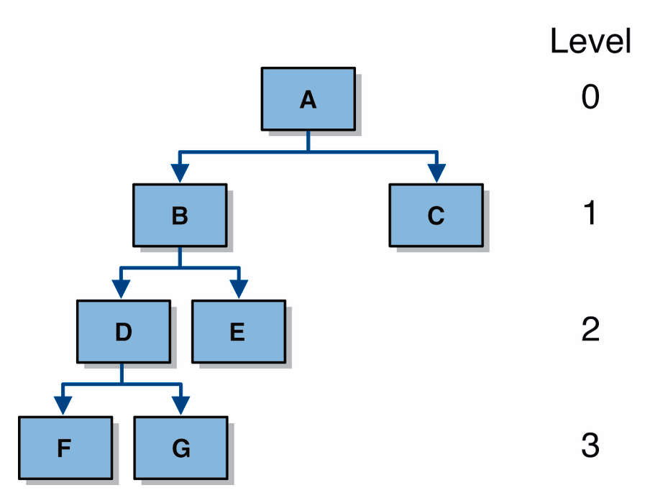
Depth and height
depth or level: length of the path from root to the current node (depth of root = 0)
height: length of the longest path from root to any leaf
  empty (null) tree's height: -1
  single-element tree's height: 0
  tree with a root with children: 1

Slide 17
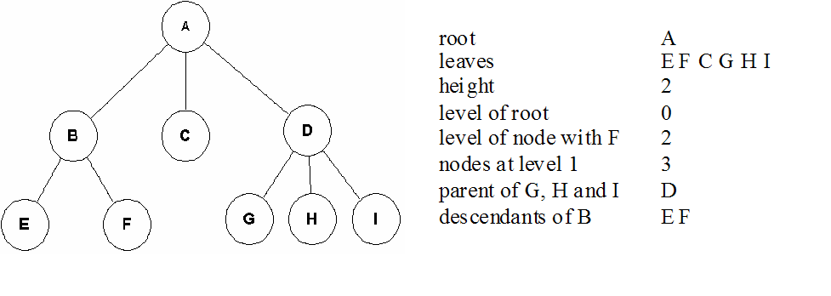
Tree example

Slide 18
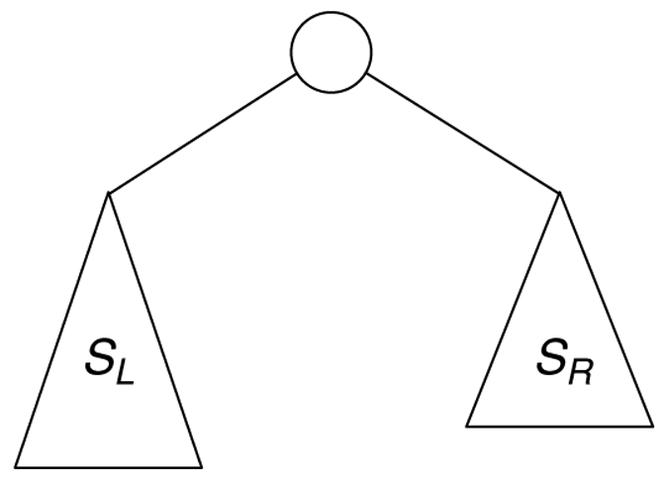
Recursive size of binary tree
Recursive view used to calculate the size of a tree:
S_{T} = S_{L} + S_{R} + 1

Slide 19
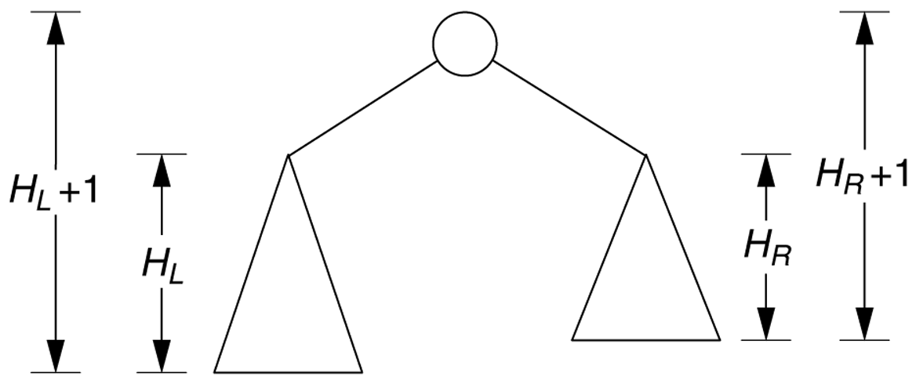
Recursive height of tree
Recursive view of the node height calculation:
H_{T} = max (H_{L} + 1, H_{R} + 1)

Slide 20
Trees in computer science
family genealogy
organizational charts
  corporate, government, military
folders/files on a computer
AI: decision trees
compilers: parse tree
a = (b + c) * d;
=
a
*
+
d
b
c

Slide 21
Trees in file systems
each folder or file is a node
  subfolders = children
C:\
tcss342
MyMail
D101
school
pers
hw1
hw2
proj1
one.java
test.java
calc.java

Slide 22
One way of implementing trees
// This won't be the way we implement our tree.
public class TreeNode {
Object element;
TreeNode firstChild;
TreeNode nextSibling;
}
C:\
tcss342
D101
MyMail
school
pers
hw1
hw2
proj1
one.java
test.java
calc.java

Slide 23
Binary trees
binary tree: a tree where all nodes have at most two children
public class BinaryTree<E implements Comparable<E>> {
private TreeNode root = null;
...
private static class TreeNode {
public E element;
public TreeNode left;
public TreeNode right;
}
}
1
2
3
4
1
5
2
3
6
4
5
6
7
7

Slide 24
Binary tree traversals
three common binary tree traversal orderings
(each one begins at the root):
  preorder traversal: the current node is processed, then the node's left subtree is traversed, then the node's right subtree is traversed (CURRENT-LEFT-RIGHT)
  in-order traversal: the node's left subtree is traversed, then the current node itself is processed, then the node's right subtree is traversed (LEFT-CURRENT-RIGHT)
  postorder traversal: the node's left subtree is traversed, then the node's right subtree is traversed, and lastly the current node is processed (LEFT-RIGHT-CURRENT)

Slide 25
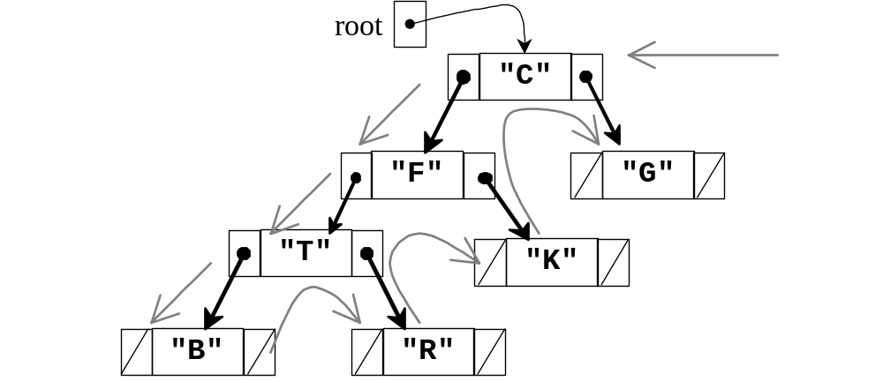
Binary tree preorder traversal
order: C F T B R K G
  The trick: Walk around the outside of the tree and emit a node's value when you touch the left side of the node.

Slide 26
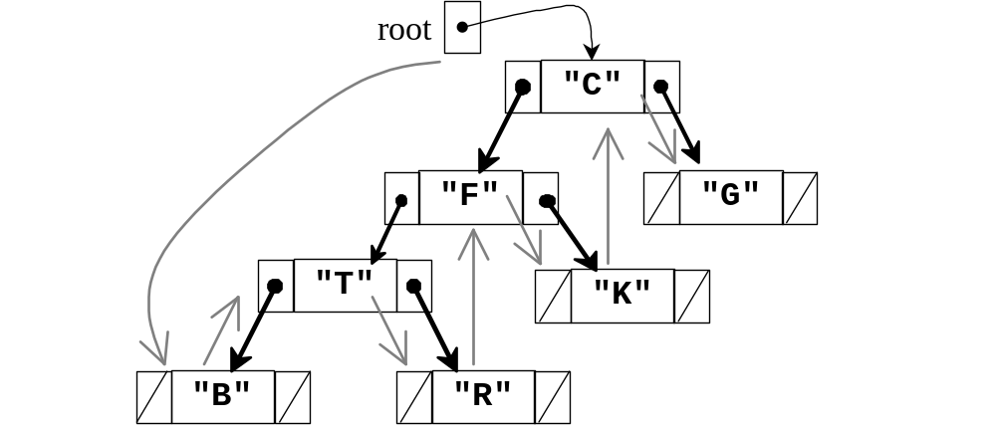
Binary tree in-order traversal
order: B T R F K C G
  The trick: Walk around the outside of the tree and emit a node's value when you touch the bottom side of the node.

Slide 27
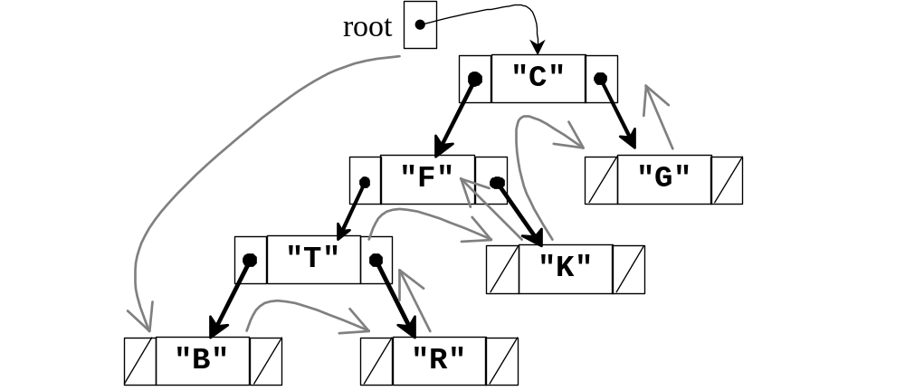
Binary tree postorder traversal
order: B R T K F G C
  The trick: Walk around the outside of the tree and emit a node's value when you touch the right side of the node

Slide 28
Traversal practice problem
Do a pre-order, in-order, and post-order traversal of the given tree. Write the nodes' values in the order they would be visited.
8
5
11
2
7
10
18
4
15
20
21

Slide 29
Infix, prefix, and postfix notation
representation of math expressions as a binary tree
  operators have their left and right operands as subtrees
  literal values are stored as leaves
notations
  prefix: Polish notation
  infix: standard notation
  postfix: reverse Polish notation

Slide 30
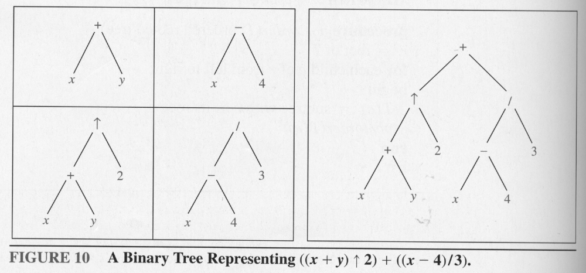
Expression example

Slide 31
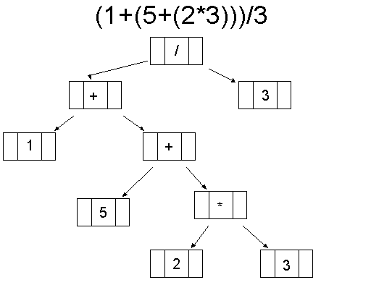
Expression tree example

Slide 32
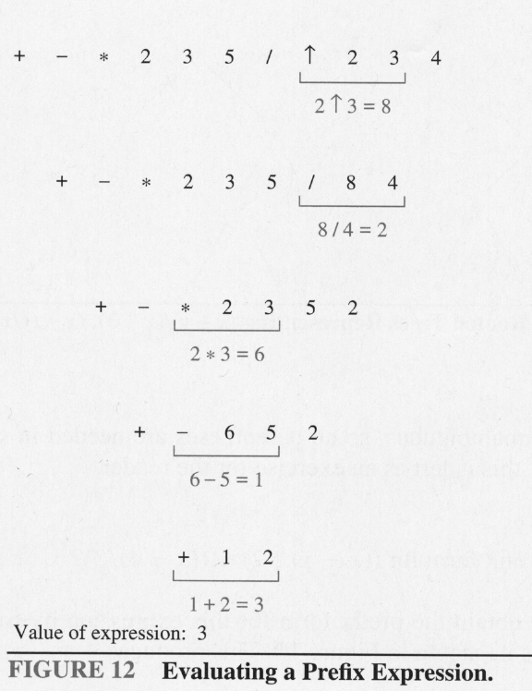
Evaluating
Evaluate this
postfix expression:
7 2 3 * - 4 ^ 2 5 / +

Slide 33
Binary Search Trees (BSTs)

Slide 34
Binary search trees
binary search tree (BST): a binary tree where every node n satisfies the following properties:
  every element in n's left subtree has a value less than n's element value
  every element in n's right subtree has a value greater than n's element value
  n's left and right subtrees are binary search trees
BSTs' elements are stored in sorted order, which is helpful for searching

Slide 35
Binary search tree examples
Which of the following two trees are BSTs?
6
5
3
8
4
8
1
4
11
1
7
11
5
3

Slide 36
Why isn't this a BST?
8
5
11
2
7
10
18
4
15
20
21

Slide 37
BST operations
a BST allows us to use a tree to implement a set collection with operations like the following:
  contains(element)
  add(element)
  getHeight
  getMin, getMax
  removeMin, removeMax
  remove(element)
  printInOrder, printPreOrder, printPostOrder

Slide 38
Searching a BST
We must be able to search a binary search tree for a given element's value, to implement the contains operation
Basic idea: compare the element e to be found to the element in the current node of the tree
  if they are equal, we are done
  if e is smaller, examine the left subtree
  if e is greater, examine the right subtree
  when can we stop searching?
BST methods are best implemented recursively

Slide 39
Implementing add
Basic idea: to add element e, find the node n that should be e 's parent, and set n 's child to be a new node containing e
to find parent node n:
  if e is smaller, examine the left subtree
  if e is greater, examine the right subtree
  if we've hit a dead end, we are done; add here

Slide 40
Implementing add
Traverse from root to expected parent; place a new tree node as parent's left or right child

Slide 41
Implementing getMin/getMax
To find the maximum element in the BST, we follow right children until we reach null
To find the minimum element in the BST, we follow left children until we reach null
5
4
8
1
7
11
3

Slide 42
Implementing remove
Removing from a BST is challenging!
Removing an item disrupts the tree structure
  We can't just delete a node like we could with a linked list.
  The tree node could have one or two children, so it's not immediately clear what should become of them.
Basic idea: Find the node that is to be removed. Then "fix" the tree so that it is still a binary search tree.
Three cases:
  node to be removed has no children
  node to be removed has one child subtree
  node to be removed has two child subtrees

Slide 43
Implementing remove
no children: just set parent's child reference to null
one child: replace the removed node with its subtree
5
5
4
8
4
8
1
7
11
1
7
11
3
3

Slide 44
Implementing remove
two children: replace the node with its successor (leftmost element of right subtree), then remove the successor from the tree
5
7
4
8
4
8
1
7
11
1
7
11
3
3

Slide 45
Tree practice problem
Draw the binary search tree that would result if the following numbers were added in this order to an initially empty tree:
  4, 7, 9, 8, 15, 3, -5, 1, 6, 4, 22, -2, -1, -3
Then give the following information about the tree:
  size
  height
  height of subtree rooted at 9
  # nodes at depth 3
Next, do a pre-order, in-order, and post-order traversal of your tree.
Lastly, remove the following numbers from the tree and show its state afterward:
  -3, 1, 6, 7, 9, 4

Slide 46
Tree size, height, runtime
for a binary tree t , of size n :
  what is the maximum height of t ?
  what is the minimum height of t ?
  what is the average height of t ?
for operations add, contains, remove, getMin, getMax, removeMin, removeMax:
  what is their runtime proportional to?
  based on the numbers above, what is the average Big-Oh for common tree operations?

Slide 47
Balanced Binary Search Trees:
The AVL Tree

Slide 48
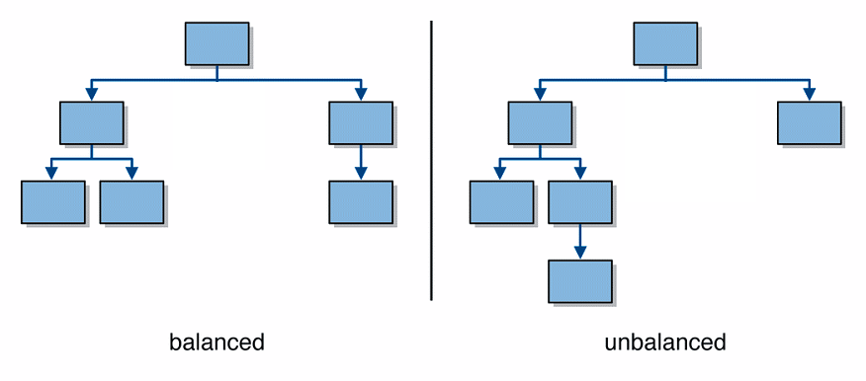
Balanced trees
A balanced tree is one where no node has two subtrees that differ in height by more than 1
  visually, balanced trees look wider and flatter

Slide 49
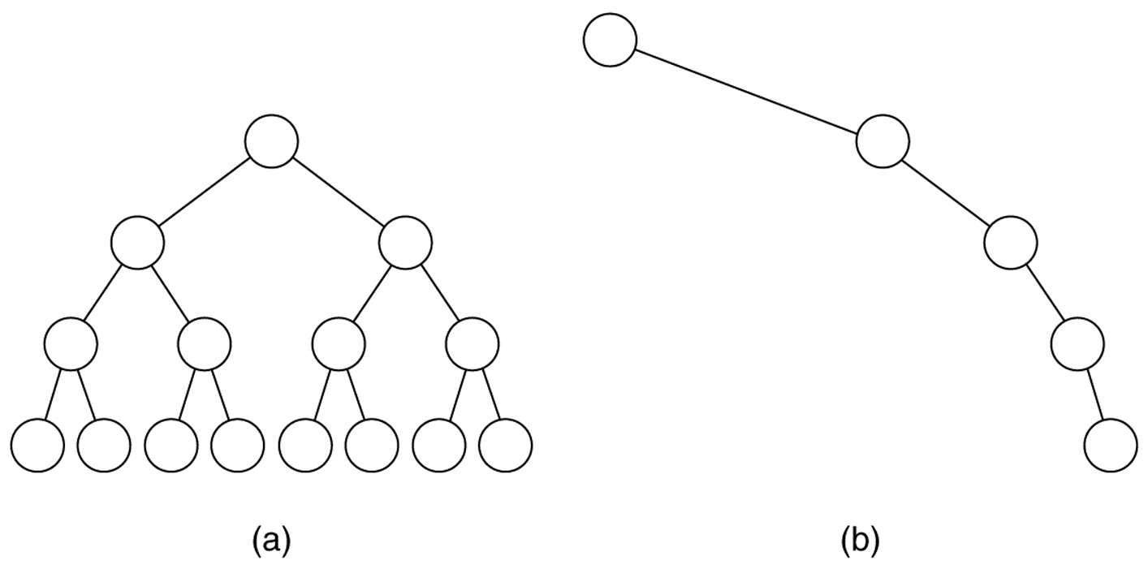
Tree balance and height
(a) The balanced tree has a height of: __________
(b) the unbalanced tree has a height of: __________

Slide 50
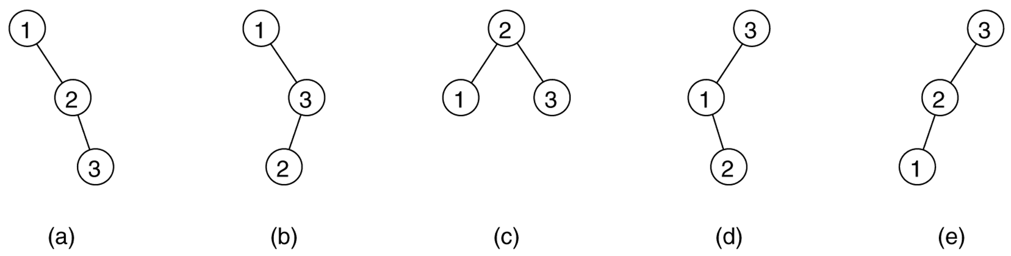
Tree balance: probabilities
binary search trees that can result from adding a random permutation of 1, 2, and 3:
  Which is most likely to occur, given random input?
  Which input orderings are "bad" or "good"?
Notes:
the balanced tree shown in part (c) is twice as likely to result as any of the others
in-order input order is bad

Slide 51
AVL trees
observation: BSTs that are balanced will have log n search time for contains; it is desirable to have a BST that stays balanced
AVL tree: a binary search tree that uses modified add and remove operations to stay balanced as items are added into it
  invented in 1960 by two Russian mathematicians:
    Georgii Maksimovich Adelson-Velskii
    Evgenii Mikhailovich Landis
  one of several auto-balancing trees (others in book)

Slide 52
AVL trees: formal definition
balance factor, for a tree node n :
  height of n's right subtree minus height of n's left subtree
  BF_{n} = Height_{n.right} - Height_{n.left}
  reminder: height of empty tree is -1
a binary search tree is an AVL tree if:
  balance factor of each node is 0, 1 or -1
  (if no node's two child subtrees differ in height by more than 1)

Slide 53
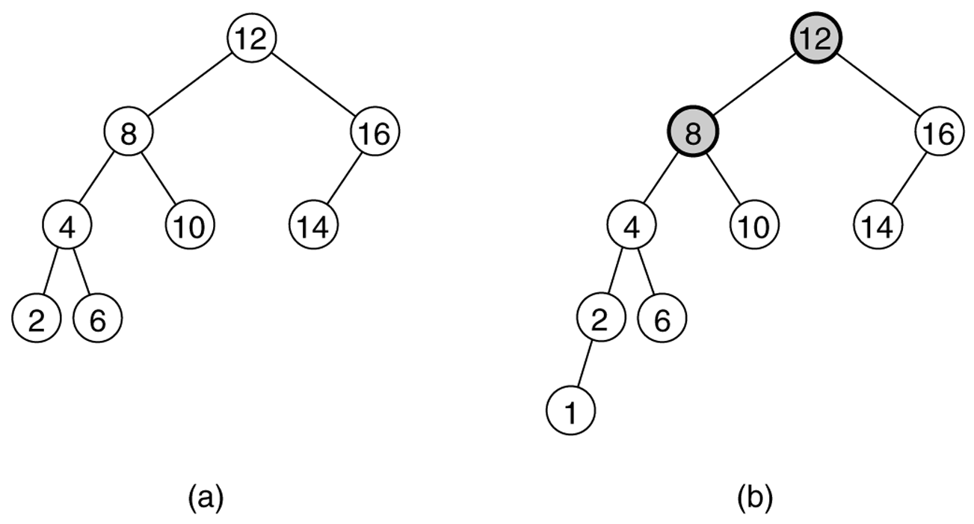
AVL tree examples
Two binary search trees:
(a) an AVL tree
(b) not an AVL tree (unbalanced nodes are darkened)

Slide 54
More AVL tree examples
1
0
-1
0
0
0
-1
0
-1
1
-1
0
0
0
0

Slide 55
Not AVL tree examples
-1
-2
-2
-1
2
-1
2
0
0
1
0
-1
0
0

Slide 56
Which are AVL trees?

Slide 57
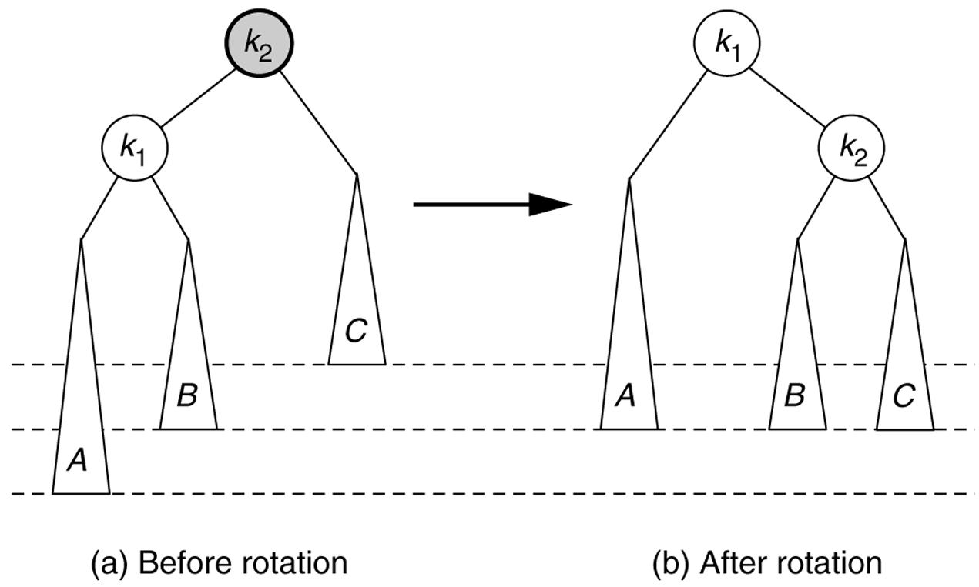
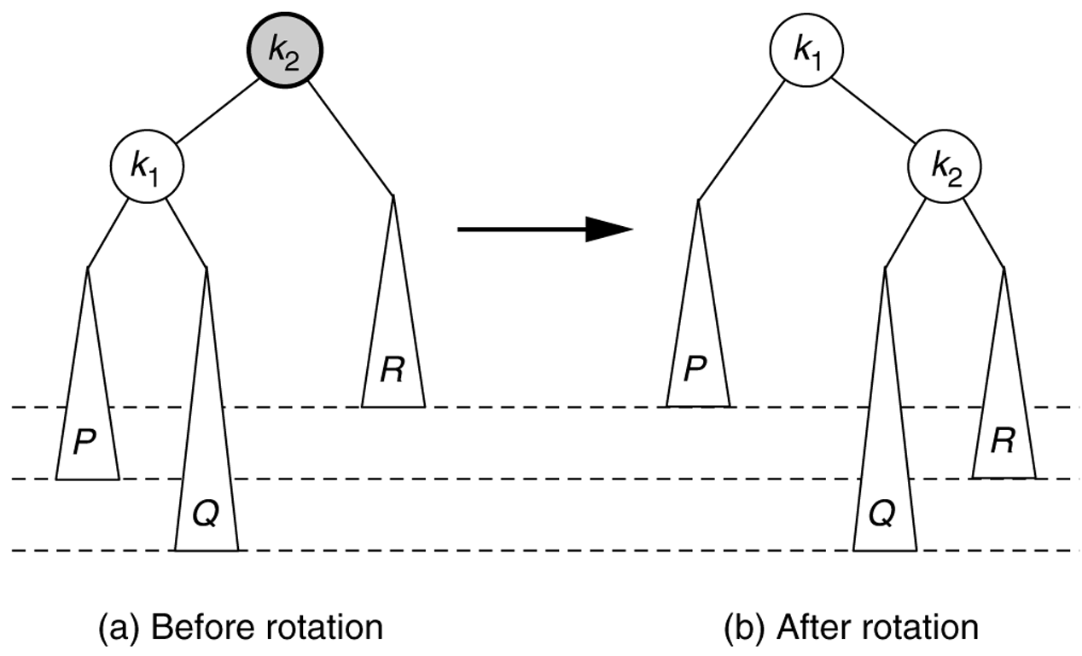
Problem cases for AVL add
1. insertion into left subtree of node's left child
2. insertion into right subtree of node's left child
...

Slide 58
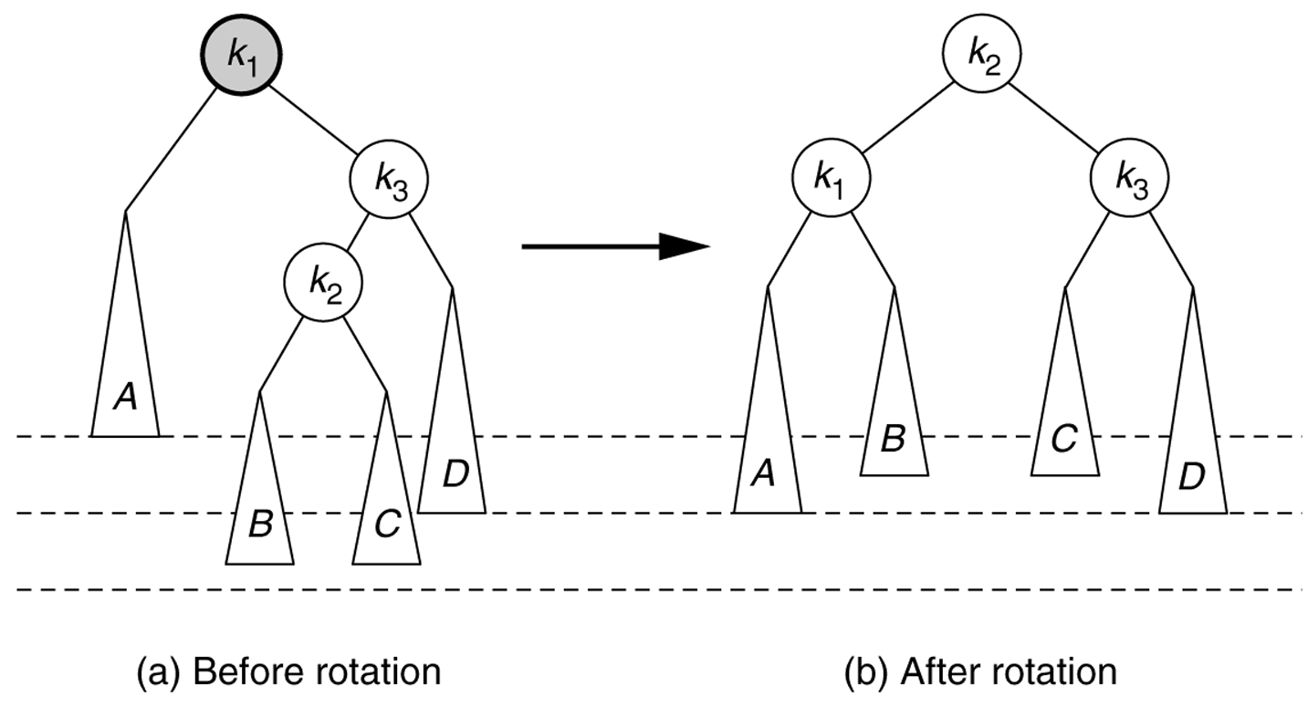
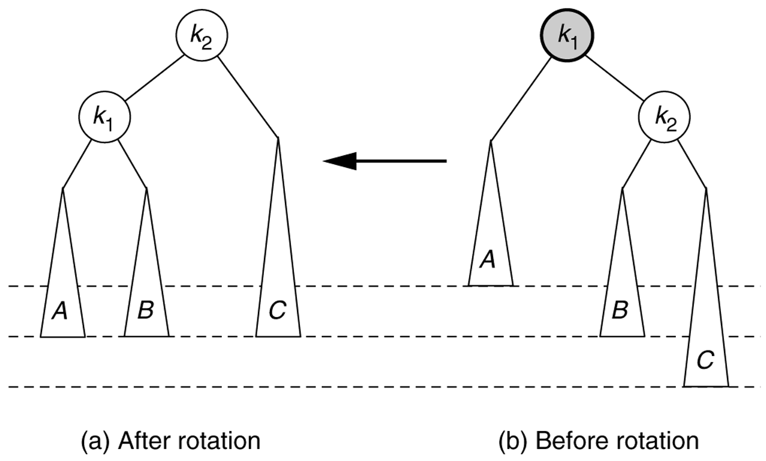
Insertion problem cases, contd
3. insertion into left subtree of node's right child
4. insertion into right subtree of node's right child

Slide 59
AVL tree data structure
potential balancing problems occur when a new element is added or removed
Maintain balance using rotations
  the idea: reorganize the nodes of an unbalanced subtree until they are balanced, by "rotating" a trio of parent - leftChild - rightChild
  tree will maintain its balance so that searches (contains) will take O(log n)
Notes:
possible optimization: at each node, keep track of height of subtree rooted at node (for balance factor computations)

Slide 60
Right rotation to fix Case 1
right rotation (clockwise): left child becomes parent; original parent demoted to right

Slide 61
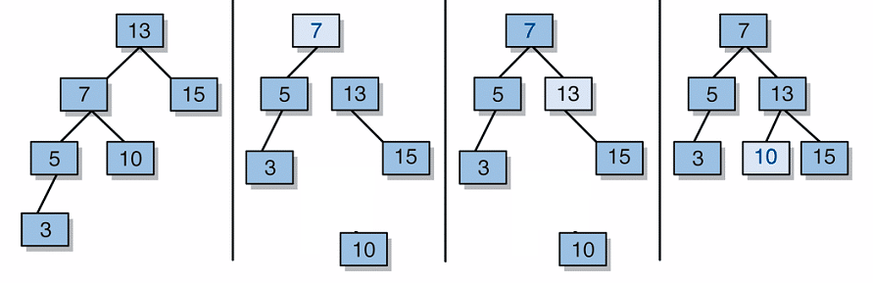
Right rotation, steps
detach left child (7)'s right subtree (10)
(don't lose it!)
consider left child (7) be the new parent
attach old parent (13) onto right of new parent (7)
attach old left child (7)'s old right subtree (10) as left subtree of new right child (13)

Slide 62
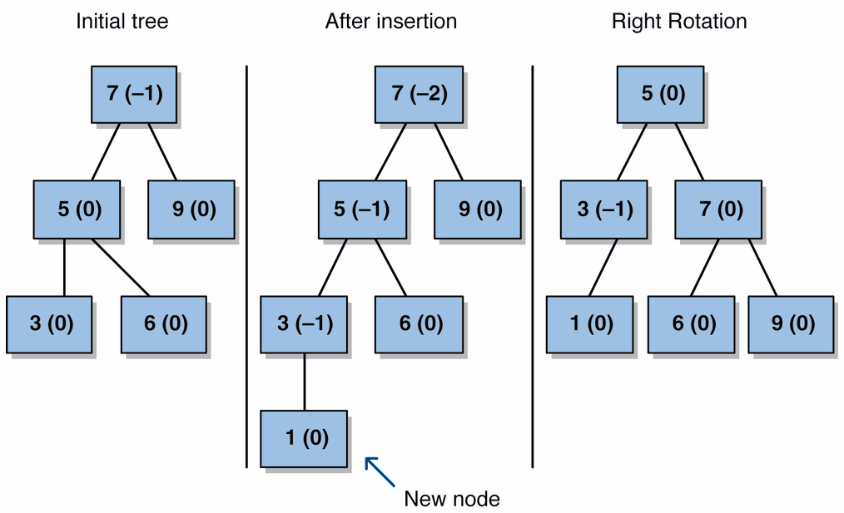
Right rotation example

Slide 63
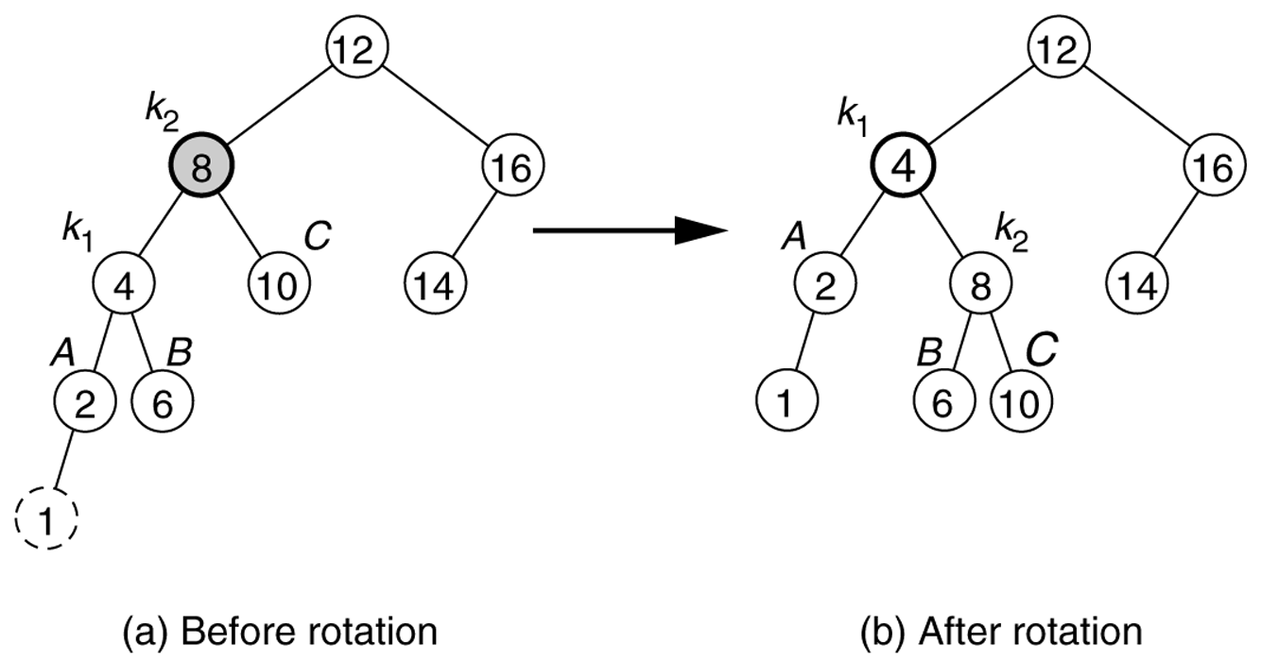
Right rotation example

Slide 64
Code for right rotation
private TreeNode rightRotate(TreeNode parent) {
// 1. detach left child's right subtree
TreeNode leftright = parent.left.right;
// 2. consider left child to be the new parent
TreeNode newParent = parent.left;
// 3. attach old parent onto right of new parent
newParent.right = parent;
// 4. attach old left child's old right subtree as
// left subtree of new right child
newParent.right.left = leftright;
return newParent;
}

Slide 65
Left rotation to fix Case 4
left rotation (counter-clockwise): right child becomes parent; original parent demoted to left

Slide 66
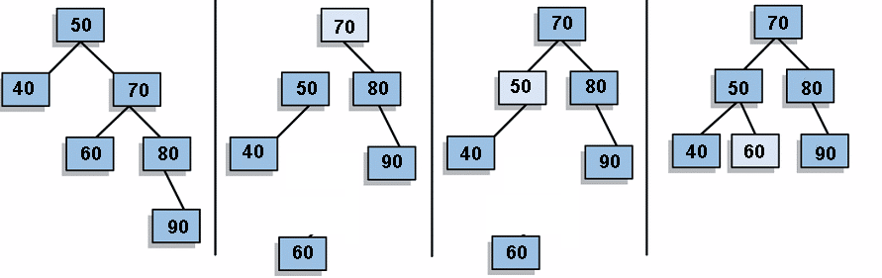
Left rotation, steps
detach right child (70)'s left subtree (60)
(don't lose it!)
consider right child (70) be the new parent
attach old parent (50) onto left of new parent (70)
attach old right child (70)'s old left subtree (60) as right subtree of new left child (50)

Slide 67
Code for left rotation
private TreeNode leftRotate(TreeNode parent) {
// 1. detach right child's left subtree
TreeNode rightleft = parent.right.left;
// 2. consider right child to be the new parent
TreeNode newParent = parent.right;
// 3. attach old parent onto left of new parent
newParent.left = parent;
// 4. attach old right child's old left subtree as
// right subtree of new left child
newParent.left.right = rightleft;
return newParent;
}

Slide 68
Problem: Cases 2, 3
a single right rotation does not fix Case 2!
a single left rotation also does not fix Case 3

Slide 69
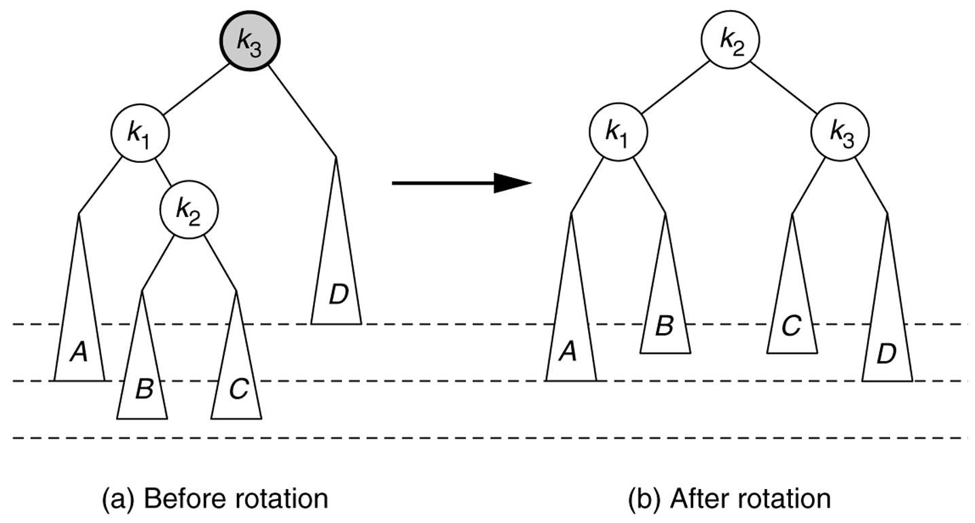
Left-right rotation for Case 2
left-right double rotation: a left rotation of the left child, followed by a right rotation at the parent

Slide 70
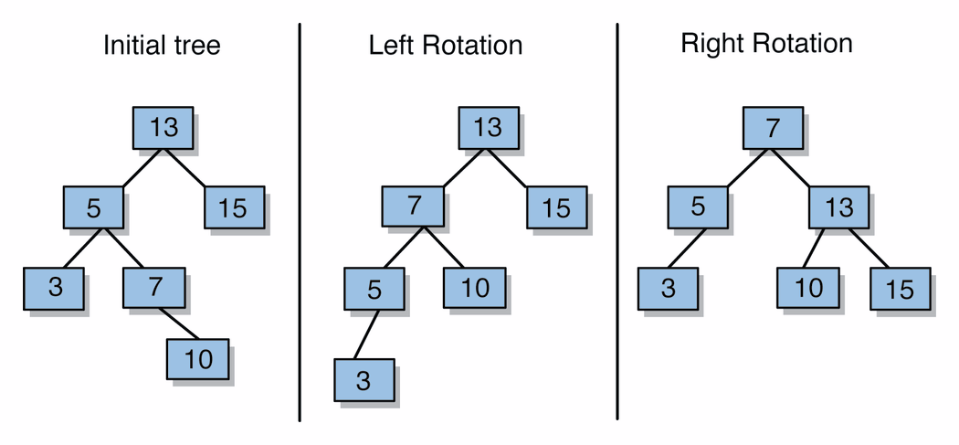
Left-right rotation, steps
perform left-rotate on left child
perform right-rotate on parent (current node)

Slide 71
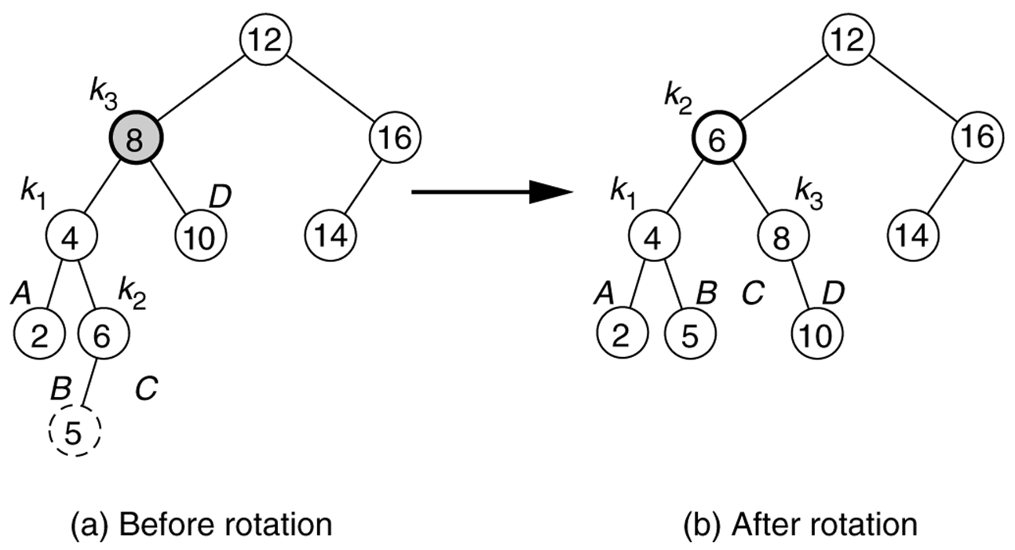
Left-right rotation example

Slide 72
Right-left rotation for Case 3
right-left double rotation: a right rotation of the right child, followed by a left rotation at the parent

Slide 73
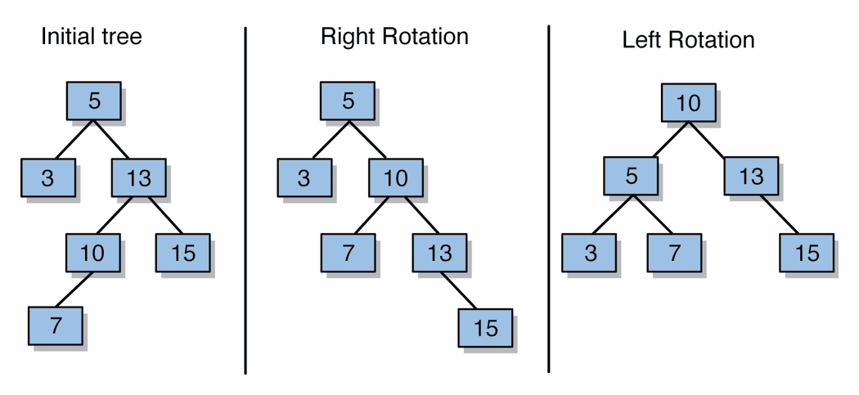
Right-left rotation, steps
perform right-rotate on right child
perform left-rotate on parent (current node)

Slide 74
AVL tree practice problem
Draw the AVL tree that would result if the following numbers were added in this order to an initially empty tree:
  40, 70, 90, 80, 30, -50, 10, 60, 40, -70, 20, 35, 37, 32, 38, 39
Then give the following information about the tree:
  size
  height
  balance factor at each node

Slide 75
Implementing AVL add
After normal BST add, update heights from new leaf up towards root
  If balance factor changes to > +1 or < -1, then use rotation(s) to rebalance
Let n be the first unbalanced node found
  Case 1: n has balance factor -2 and n's left child has balance factor of –1
    fixed by performing right-rotation on n
  Case 2: n has balance factor -2 and n's left child has balance factor of 1
    fixed by perform left-rotation on n's left child, then right-rotation on n (left-right double rotation)

Slide 76
AVL add, cont'd
  Case 3: n has balance factor 2 and n's right child has balance factor of –1
    fixed by perform right-rotation on n's right child, then left-rotation on n (right-left double rotation)
  Case 4: n has balance factor 2 and n's right child has balance factor of 1
    fixed by performing left-rotation on n
After rebalancing, continue up the tree updating heights
  What if n's child has balance factor 0?
  What if another imbalance occurs higher up?
Notes:
If A has balance factor –2, then
A’s left child cannot have balance factor 0
A’s left child has balance factor is –1 if and only if new node was added to subtree rooted at A’s leftmost grandchild
A’s left child has balance factor is 1 if and only if new node was added to subtree rooted at A’s left child’s right child

Slide 77
Code for AVL add
protected TreeNode add(TreeNode node, E element) {
node = super.add(node, element);
node = rebalance(node);
return node;
}
protected TreeNode rebalance(TreeNode node) {
int bf = balanceFactor(node);
if (bf < -1) {
if (balanceFactor(node.left) < 0) { // case 1 (R)
node = rightRotate(node);
} else { // case 2 (LR)
node.left = leftRotate(node.left);
node = rightRotate(node);
}
} else if (bf > 1) {
if (balanceFactor(node.right) < 0) { // case 3 (RL)
node.right = rightRotate(node.right);
node = leftRotate(node);
} else { // case 4 (L)
node = leftRotate(node);
}
}
return node;
}

Slide 78
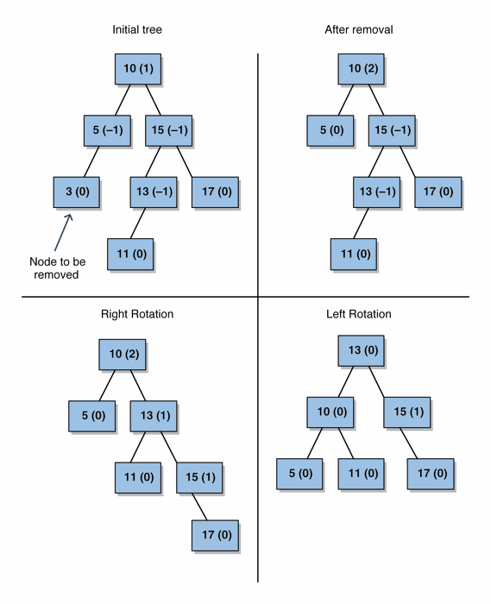
Problems for AVL remove
removal from AVL tree can also unbalance the tree

Slide 79
Right-left rotation on remove

Slide 80
AVL remove, cont'd
perform normal BST remove (with replacement of node to be removed with its successor)
update heights from successor node location upwards towards root
  if balance factor changes to +2 or -2, then use rotation(s) to rebalance
remove has the same 4 cases (and fixes) as insert
  are there any additional cases?
After rebalancing, continue up the tree updating heights; must continue checking for imbalances in balance factor, and rebalancing if necessary
  Are all cases handled?

